Slide 1
Tries
Computer Science, Purdue University
Copyright Wiley, Goodrich and Tamassia

Slide 2
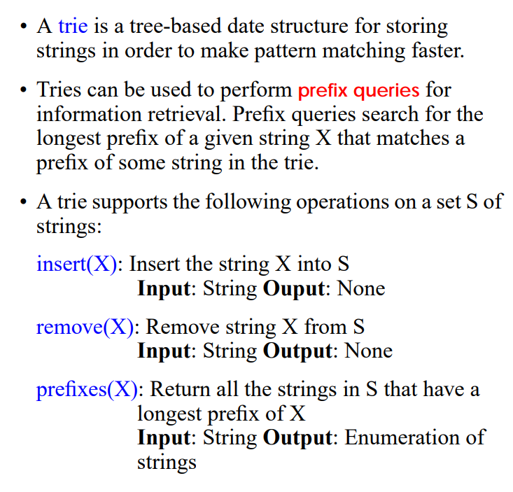
Tries
Abstract Data Type
Computer Science, Purdue University

Slide 3
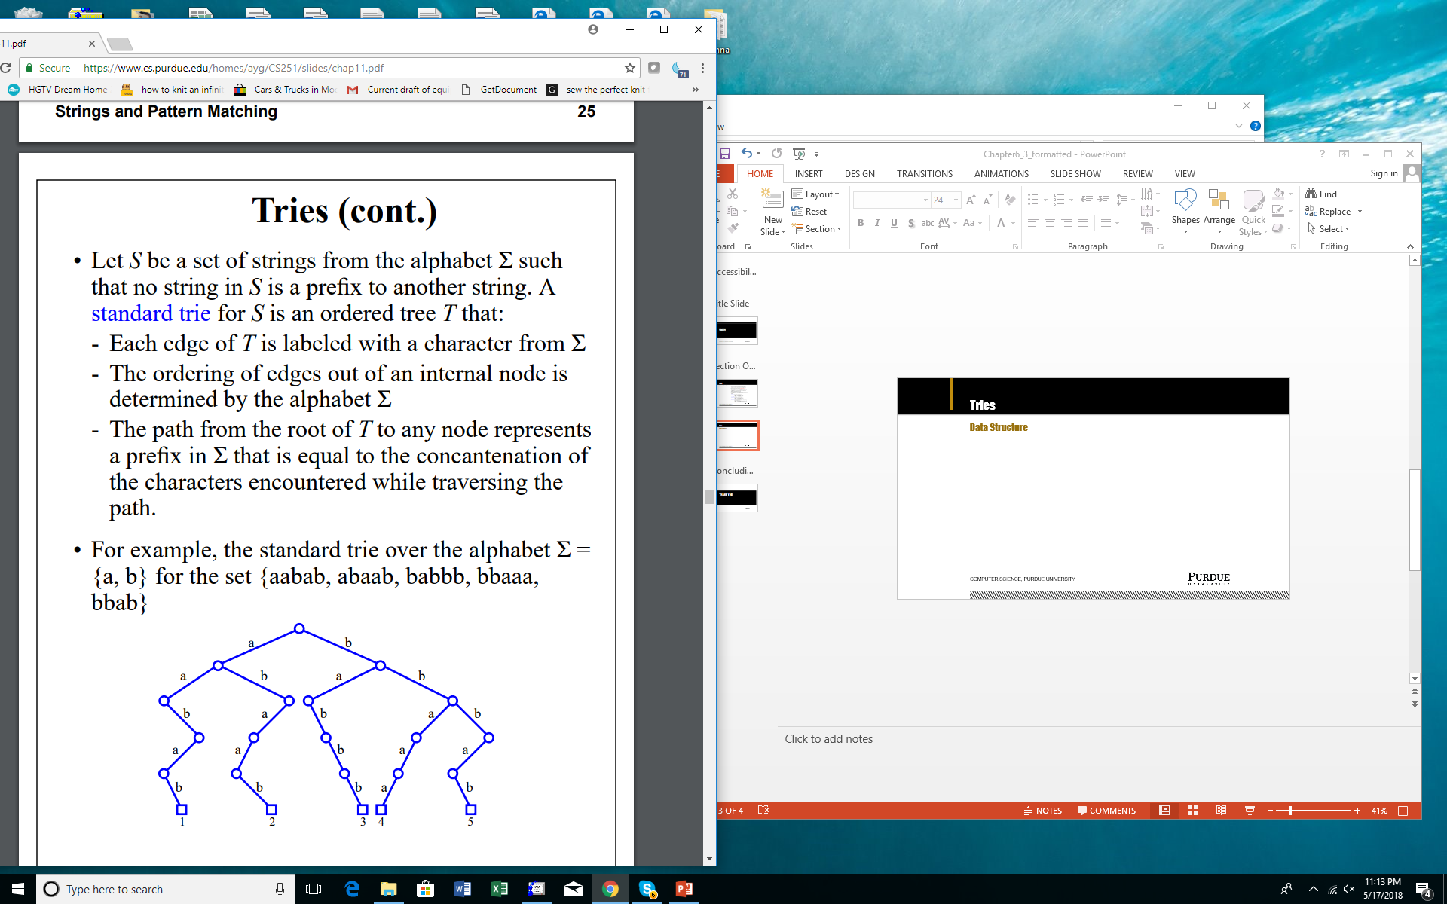
Tries
Data Structure
Computer Science, Purdue University

Slide 4
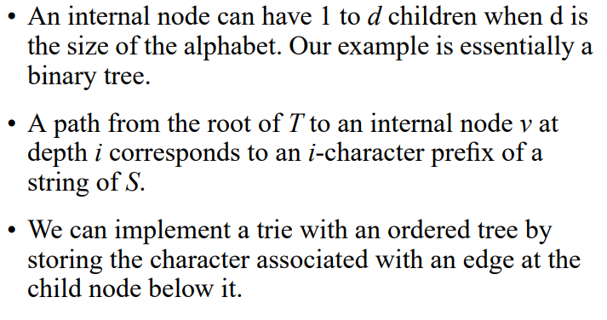
Tries
Data Structure
Computer Science, Purdue University

Slide 5
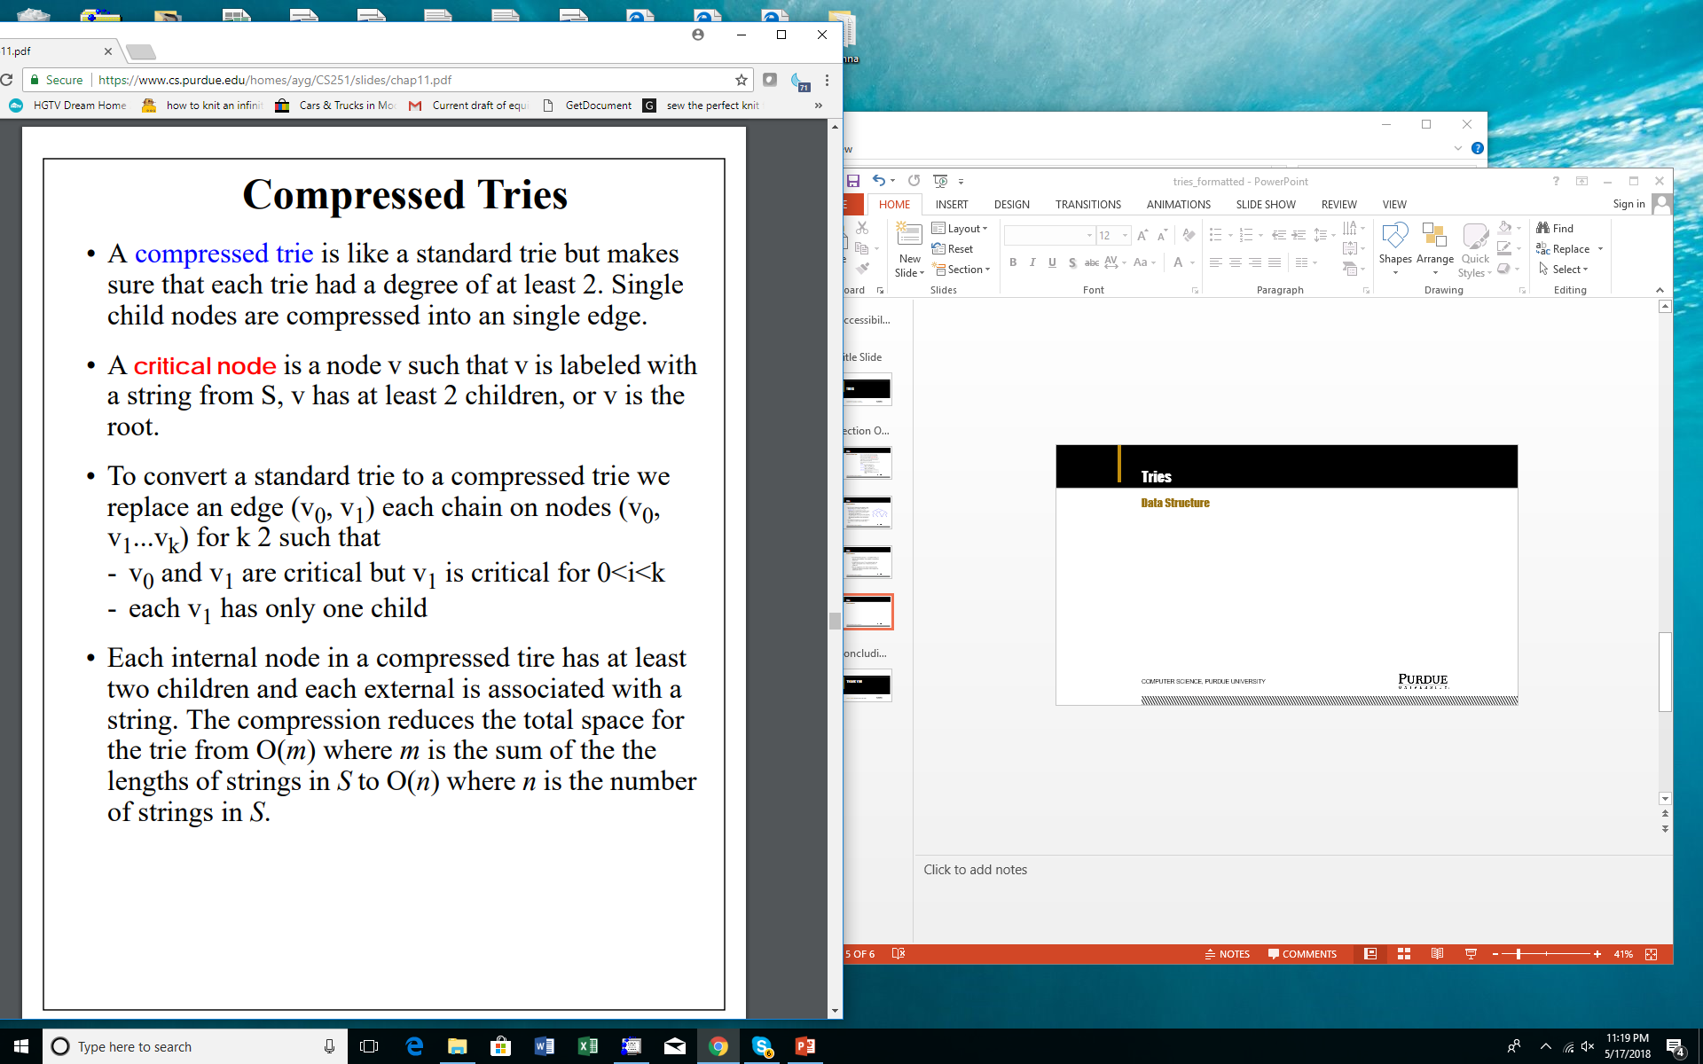
Tries
Compressed Tries
Computer Science, Purdue University

Slide 6
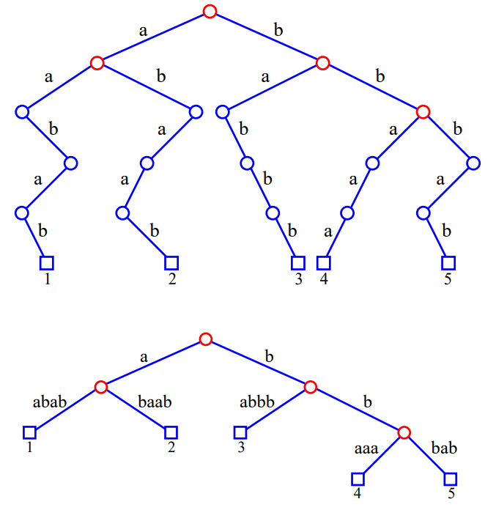
Tries
Compressed
Tries
Computer Science, Purdue University

Slide 7
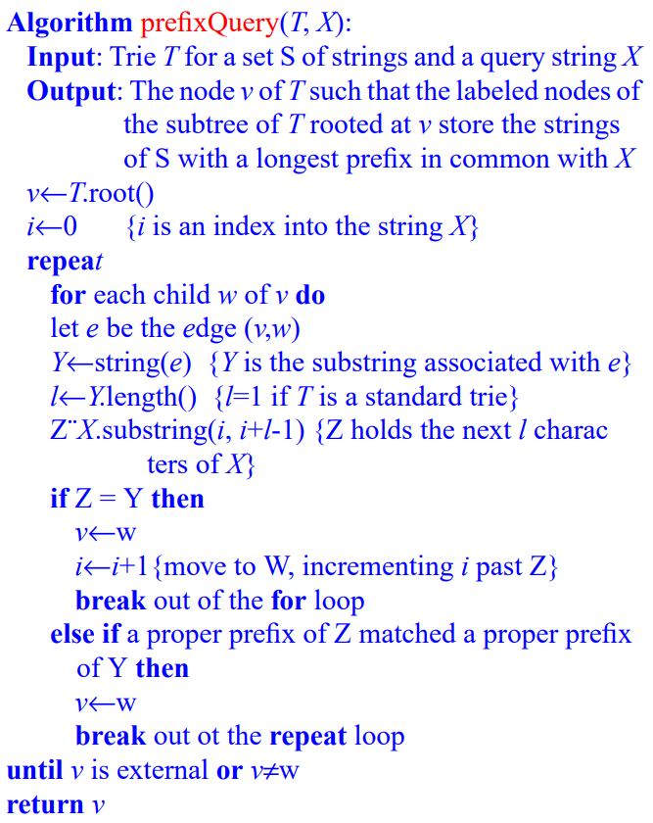
Tries
Lookup
Computer Science, Purdue University

Slide 8
Tries
Insertion and Deletion
Insertion: We first perform a prefix query for string X. Let us examine the ways a prefix query may end in terms of insertion.
The query terminates at node v. Let X₁ be the prefix of X that matched in the trie up to node v and X₂ be the rest of X. If X₂ is an empty string, we label v with X. Otherwise we create a new external node w and label it with X.
The query terminates at an edge e=(v, w) because a prefix of X matched prefix(v) and a proper prefix of string Y associated with e. Let Y₁ be the part of Y that X matched and Y₂ the rest of Y. Likewise for X₁ and X₂. Then X=X₁+X₂ = prefix(v) +Y₁+X₂. We create a new node u and split the edges(v, u) and (u, w). If X₂ is empty then we label u with X. Otherwise we create a node z which is external and label it X.
Insertion is O(dn) when d is the size of the alphabet and n is the length of the string to insert.
Computer Science, Purdue University

Slide 9
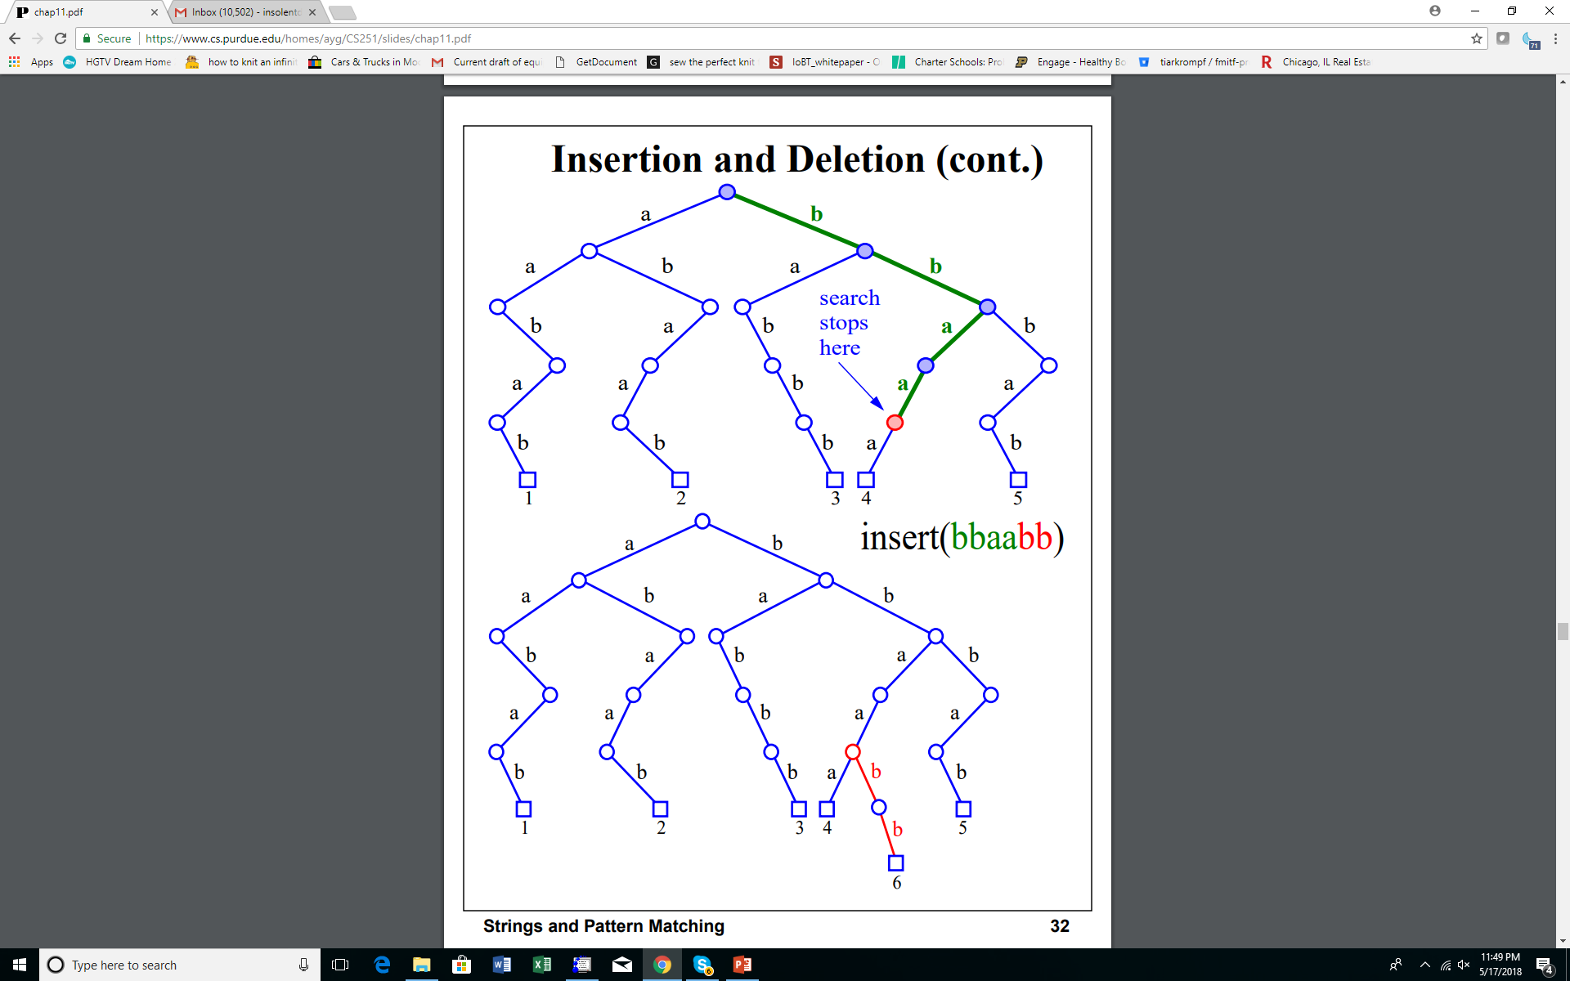
Tries
Insertion and Deletion
Computer Science, Purdue University

Slide 10
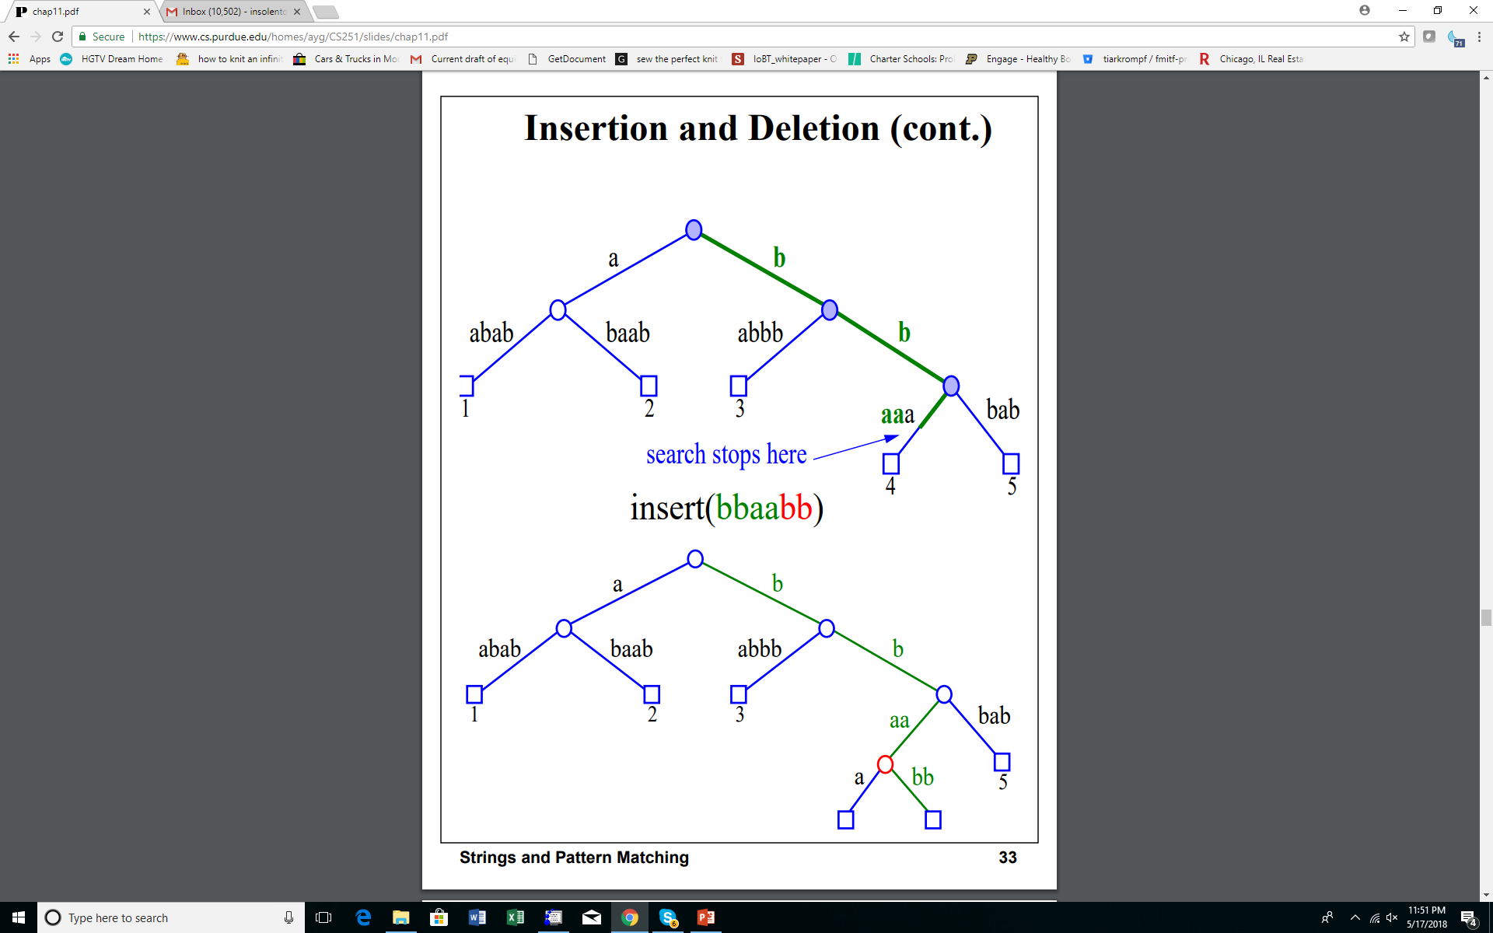
Tries
Insertion and Deletion
Computer Science, Purdue University

Slide 11
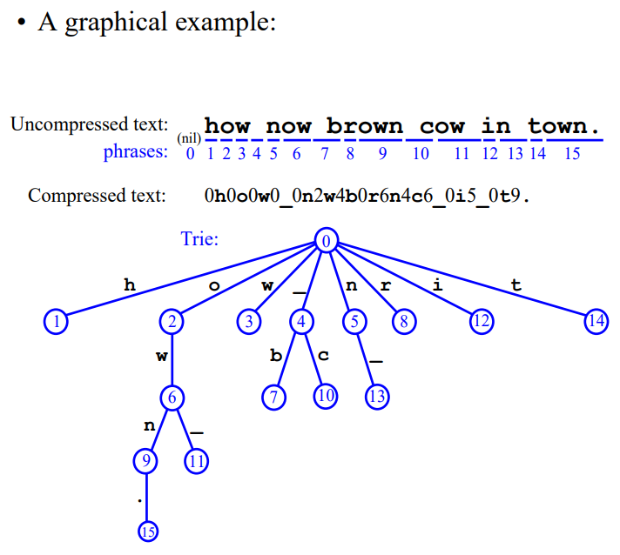
Tries
Lempel Ziv Coding
Computer Science, Purdue University

Slide 12
Thank You

